Slide 1
云计算技术
陈果 副教授
湖南大学-信息科学与工程学院-计算机与科学系
邮箱：guochen@hnu.edu.cn
个人主页：1989chenguo.github.io
https://1989chenguo.github.io/Courses/CloudComputing2018Spring.html

Slide 2
What we have learned
What is cloud computing
Cloud Networking
Physical Structure
Applications and network traffic
Host networking virtualization
Addressing & Routing
Software-Defined Networking Architecture
Inter-data-center networking
Content distribution networks
What is CDN
How to accelerate CDN
Two case-study
Anycast; VDN

Slide 3
Client connectivity
Part I: Cloud networking
Most materials from UIUC MOOC
Ankit Singla
ETH Zürich
P. Brighten Godfrey
UIUC
Credits to

Slide 4

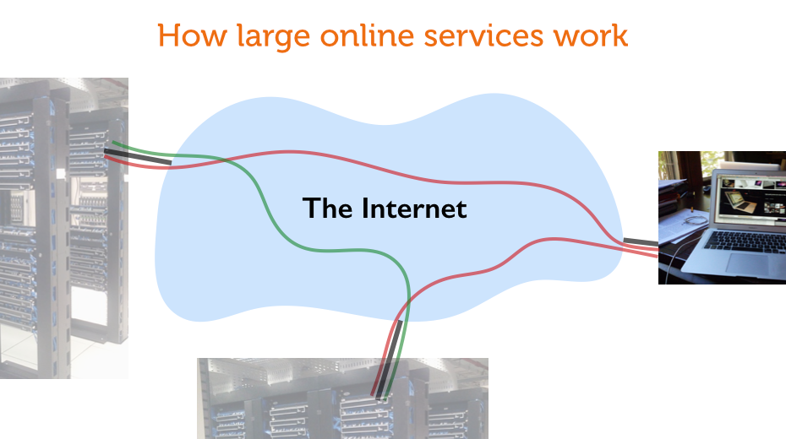

Slide 5
High bandwidth, low latency
Multiplayer
gaming
Web browsing
File sharing
Online music
collaboration
Telesurgery
Video streaming
Remote virtual
reality
Notes:
Different Internet applications place different requirements on the network. Applications like file sharing and video streaming are not particularly latency sensitive, but benefit from high bandwidth. For Web browsing, the benefits of increasing bandwidth diminish after hitting a few Mbps, with latency quickly becoming the bottleneck. Several other applications, like multiplayer gaming, remote surgery and remote virtual reality immersion and online music collaboration depend on extremely low latency and also require high bandwidth.

Slide 6
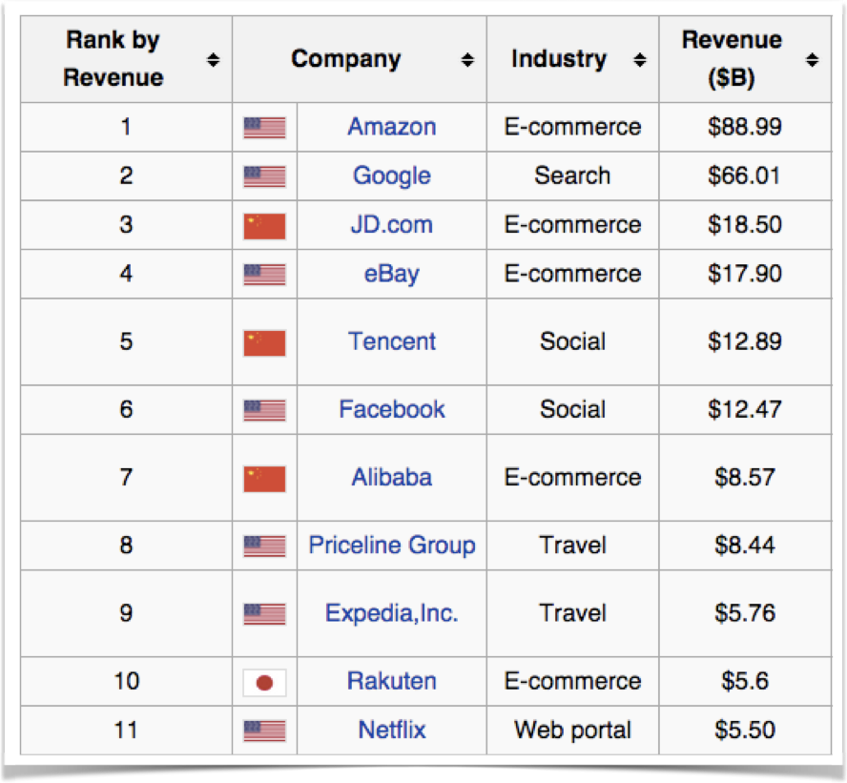
High bandwidth, low latency
wikipedia.org
“Globally, consumer internet video traffic will be 80 percent of all consumer Internet traffic in 2019, up from 64 percent in 2014.”
— Cisco
So is it all about bandwidth then?
80% traffic ≠ 80% value
Notes:
We often hear about how the majority of Internet traffic is already video, and video will form an even larger fraction of Internet traffic in the coming years. Cisco says … “”. Given that video streaming can tolerate several seconds of latency through buffering, is it all just about bandwidth then?
No. For one, 80% of traffic isn’t the same as 80% of value. Value across different applications is hard to quantify, but there are certainly a lot of high value Internet businesses whose value doesn’t stem from video streaming.

Slide 7
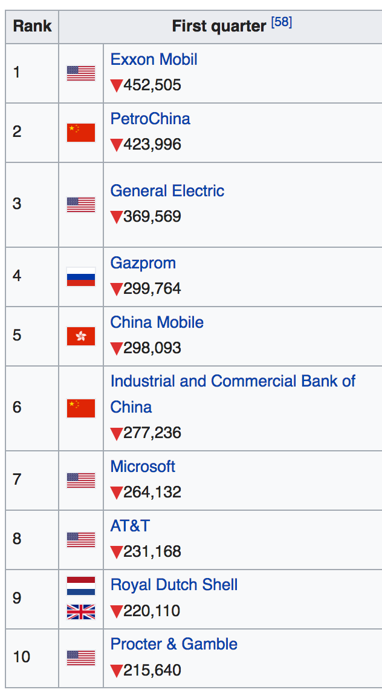
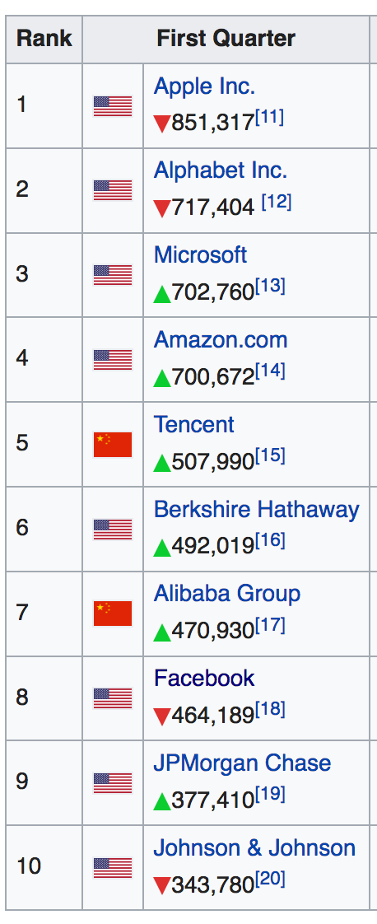
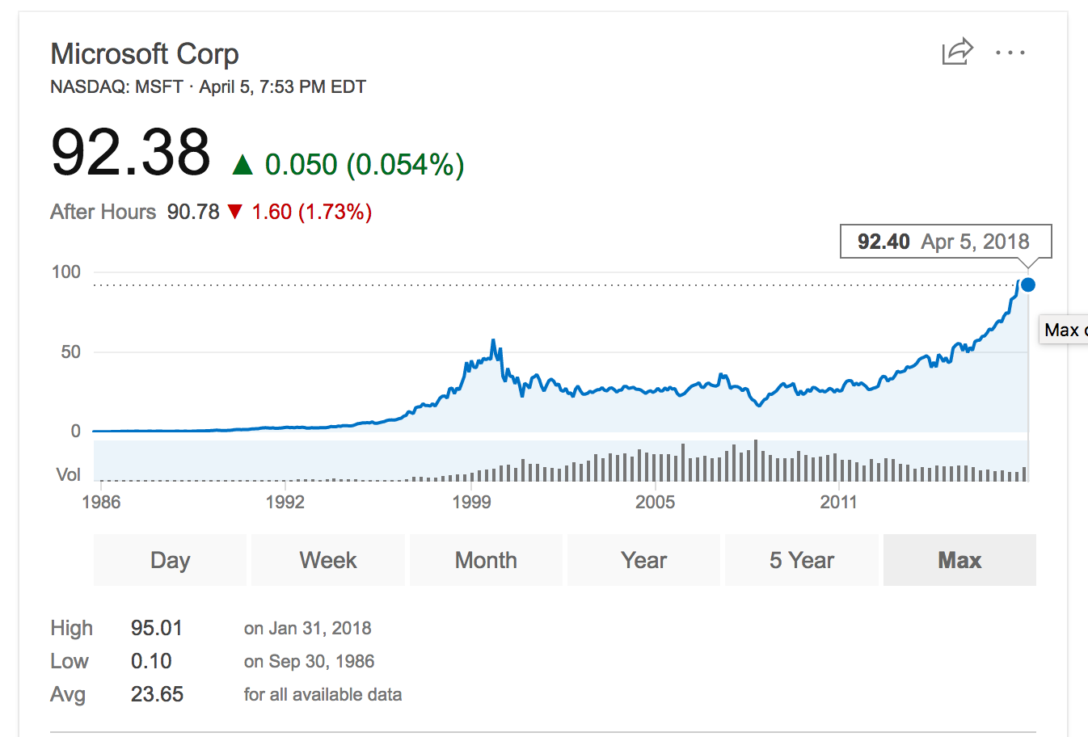
Largest corporations by market capitalization
2008 Q1
2018 Q1
https://en.wikipedia.org/wiki/List_of_public_corporations_by_market_capitalization#2000%E2%80%932010

Slide 8
Reduction in searches relative to control group
Notes:
And for many of these other Internet applications, latency really matters! How much? One experiment to place value on latency was conducted by Google. The experiment entailed adding artificial server-side delays to the Google search page’s performance for a set of users and comparing the volume of searches they made with a control group of other users. The results from that experiment are shown here in this plot. ….
Google for example, has noted that an additional delay of 400ms in their search page load time translates to fewer searches by users, showing that even small latencies impact user experience and hence service provider revenue.

Slide 9
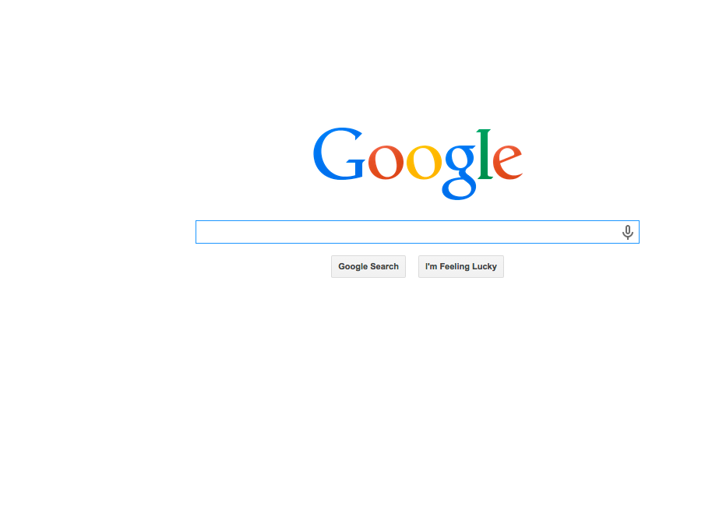
0.4s ~ 0.74% fewer searches
Notes:
And many of these other Internet applications are latency sensitive. Google for example, has noted that an additional delay of 400ms in their search page load time translates to fewer searches by users, showing that even small latencies impact user experience and hence service provider revenue.

Slide 10

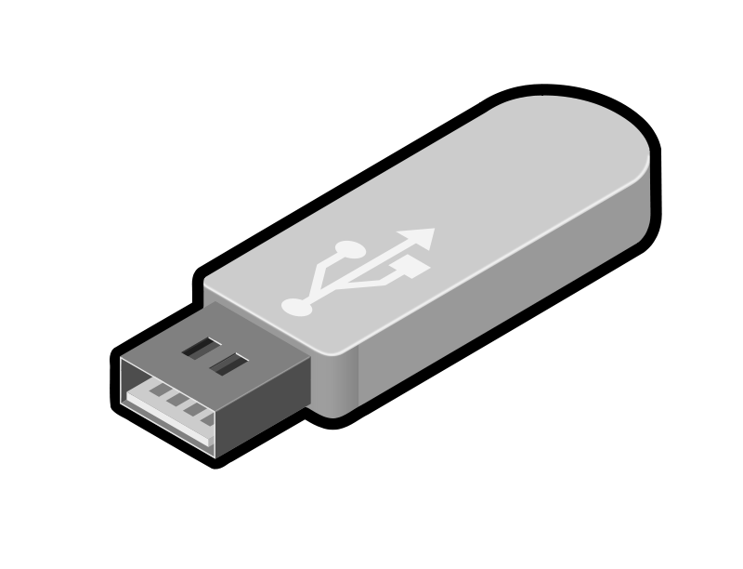
[Dean Wolstenholme, public domain, via Wikimedia Commons]
NY → SF: 4000km
@ pigeon-speed of 80kmph: 50h
1TB in 50h = 44Mbps
44 Mbps bandwidth
100 hour round-trip latency
1TB
Notes:
Let’s do a fun although somewhat extreme example that draws the contrast between bandwidth and latency and why we need to care about both.
New York to San Francisco is roughly 4000km one-way. A carrier-pigeon, at 80kmph, would take 50 hours to cover this distance. Let’s strap today’s highest-capacity USB thumb drive (1Terabyte) to our pigeon. This translates to a bandwidth of 44Mbps, but the round-trip latency is 100 hours!
Bandwidth is good, but we also need low latency.
Also, it’s worth pausing for a moment to appreciate that pigeons were among the fastest methods of long-distance communication less than a century back! We’ve come a long way!

Slide 11

High bandwidth, low latency
Communications of the ACM, 2004
Bandwidth matters …
… but even “Ultra HD” will need only 15Mbps
… and ISPs are competing on bandwidth
Latency matters too …
… and in fact, is (or will be) the bottleneck for many apps
… and is typically a more difficult problem
… and is fundamentally bounded by the speed of light
Notes:
So, while bandwidth does matter, even ultra HD streams will only need 15Mbps, and ISPs are aggressively competing on bandwidth in many markets. I appreciate fully that in many places most connections are still low bandwidth, but the situation is improving.
Meanwhile, low latency is crucial as well, and will be the bottleneck for many applications, including Web browsing. Achieving lower latency is typically a harder problem than higher bandwidth — this has been noted in a variety of contexts. Further, latency is fundamentally bounded by the speed of light — a Delhi to New York round-trip will require more than around 80ms, no matter the networking technology we use.

Slide 12

Map adapted from image by Ktrinko (Own work) [CC0], via Wikimedia Commons
CDNs help, but not in all use cases
Notes:
Content distribution networks are one way of addressing this problem. They help by moving content closer to end users, reducing physical distance and thus latency. Another lesson in this course discusses in detail the CDN approach. But, not every service is hosted on a CDN, and for things like multi-player gaming between players that are geographically separated we cannot cut down the physical distance by using a CDN.
So we need the network itself to provide low latency. And this is complementary to CDNs — CDNs themselves will benefit from lower latency networking.

Slide 13
A toy experiment
$ wget theoatmeal.com
430ms (fetch size 20KB)
$ ping 208.70.xxx.yy
55ms
Champaign-Portland roundtrip distance
5700 kilometers
19ms at the speed of light in vacuum
23x inflation over c-latency!
Notes:
Let’s look at a toy experiment to see what latency on the Internet looks like. I used the linux wget command-line tool to fetch just the index.html of the the landing page of this popular website. (I’ve obscured the URL so all of you don’t hammer their servers.)
This took 430ms to fetch just 20KB.
Next, I pinged a server hosting this website, which took 55ms.
I geolocated the server to Portland in the US, which is less than 6000 Km from my location in Champaign. This would be merely 19ms at the speed of light in vacuum, c.
So, in this case, the Internet is 23x slower than it could be! And clearly, for 20KB, we’re not bandwidth limited.
It’s worth nothing that the speed of light in optical fiber is closer to 2/3rd of c, the speed of light in vacuum, but that’s not fundamental — in fact, there are niche networks today being operated over a nearly c-latency medium.

Slide 14
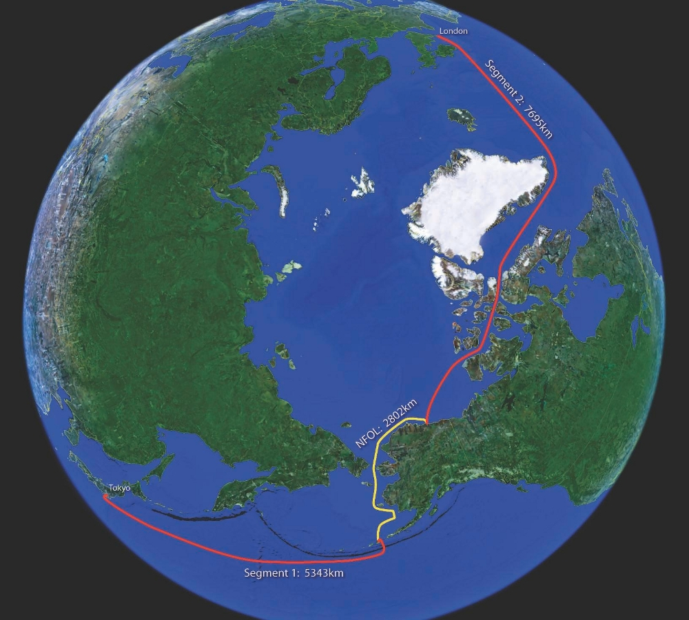
Arctic Fiber
Notes:
This one cable system is being built at the cost of $850 million. Further, ‘space Internet’ projects (using satellites to provide coverage where there’s none), have been announced, expected to cost billions of dollars.

Slide 15
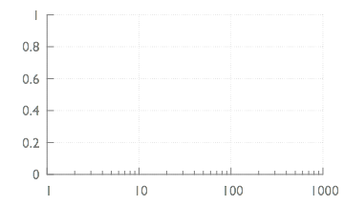
The Internet is too slow
CDF
Inflation over c-latency to the Web server
Notes:
Let’s broaden that experiment a bit. Here I’ll show you results from nearly 3 million fetches of popular Web pages from clients around the globe. In each case, we’re only getting the HTML of the landing page — so usually 10s of kilobytes. On the x-axis is latency inflation, compared with the speed-of-light latency to the each respective Web server’s location, i.e., the number corresponding to “23” in that toy example. On the y-axis is the CDF across the page fetches.

Slide 16
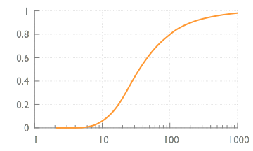
The Internet is too slow
CDF
35x
Inflation over c-latency to the Web server
Notes:
The median page takes 35 times the time it would take to fetch over a ubiquitous speed of light Internet. Note the logarithmic x-axis — in a significant fraction of cases, the inflation is over 100x.
That’s a rather large slowdown! Where does this latency come from? Let me tell you a bit more about the experiment setup that will help us answer that question.

Slide 17
Measuring latency
186 PlanetLab nodes as clients
Fetch (using cURL) thousands of Web pages each
Gather data at each layer for each page
Notes:
I used 186 clients, which are located at universities across the globe, as part of a global testbed called PlanetLab. From each client, I fetched, using the Linux cURL command-line tool, thousands of popular Web pages. From cURL, I gathered data about the time to resolve the DNS, the time to establish the TCP connection, and the time it took TCP to transfer the html data. Let’s look at how latency breaks down into these components.

Slide 18
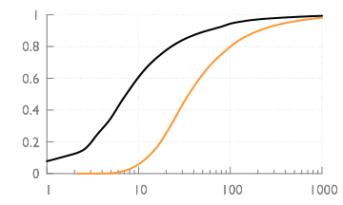
Latency inflation breakdown
DNS
CDF
35x
7.4x
Inflation over c-latency to the Web server
Notes:
We’ll focus here on the median numbers, although the tails are also interesting. In the median, DNS took 7.4 times longer than the c-latency. Notice that for some fraction of pages (around 10%), DNS was faster than c-latency — this is simply because the DNS server may be located closer than the actual server serving the page, and we’re using the latter as the baseline.

Slide 19
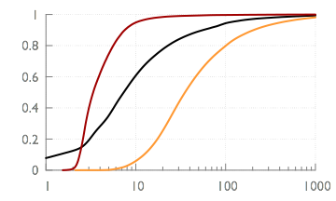
Latency inflation breakdown
TCP handshake
(2-way)
DNS
CDF
3.4x
35x
7.4x
Inflation over c-latency to the Web server
Notes:
The TCP handshake, considering only the time between sending the SYN to the server and receiving the the SYN-ACK is 3.4x inflated in the median.

Slide 20
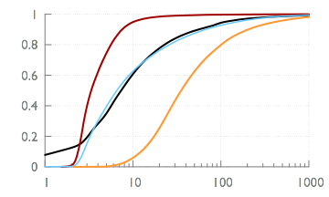
Latency inflation breakdown
Request-
response
TCP handshake
(2-way)
DNS
CDF
3.4x
6.6x
35x
7.4x
Inflation over c-latency to the Web server
Notes:
The time between sending the ACK, together with the GET request, to receiving the first byte from the server, labeled here as the request-response time, is 6.6x inflated in the median. This time includes the server’s processing time — using the TCP 2-way handshake as an estimate of the RTT, the server’s processing time is similar to one RTT, i.e., around a tenth of the total time. For these fetches, the server’s processing time is a small fraction of total page fetch time.

Slide 21
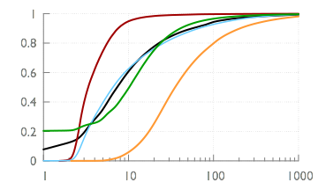
Latency inflation breakdown
TCP transfer
Request-
response
TCP handshake
(2-way)
DNS
CDF
3.4x
6.6x
10.2x
35x
7.4x
Inflation over c-latency to the Web server
(Don’t expect numbers to add up; these are all medians)
Notes:
Lastly, TCP using its multiple round trips moves the data to the client, being 10.2x inflated in the median. Note that the medians of these latency components will not add up; this is expected — the tails of their distributions are long, and that means that the median total time will be larger than the sum of the medians of these latency components.

Slide 22
Case study: Accelerating webpage load time

Slide 23
Some background first:
How a webpage is loaded and displayed
Materials from https://varvy.com/pagespeed/display.html
Notes:
Next, we’ll look at an improvement at the transport layer.

Slide 24
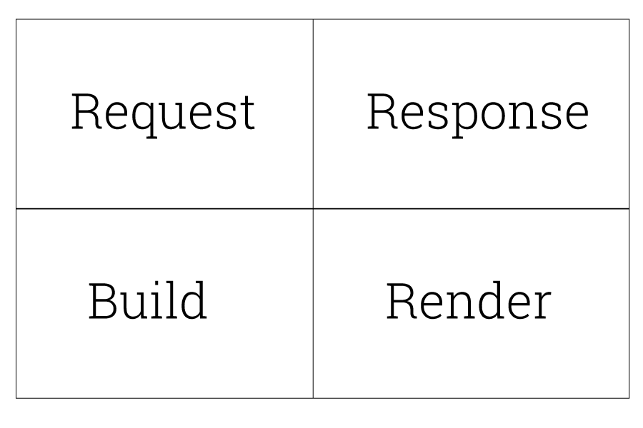
4 steps to display a webpage
Request
A request is made when a link is clicked
Response
The page and its resources (files) are downloaded
Build
The web browser uses the page resources to build the page
Render
The page then is rendered (displayed) to the user

Slide 25
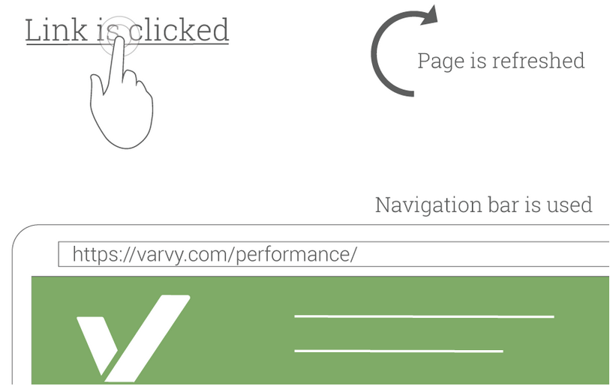
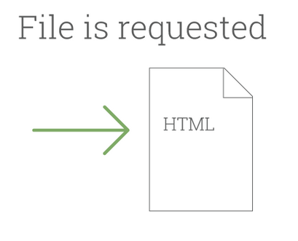
Request
HTTP request
HTTP(S)
SSL
TCP

Slide 26
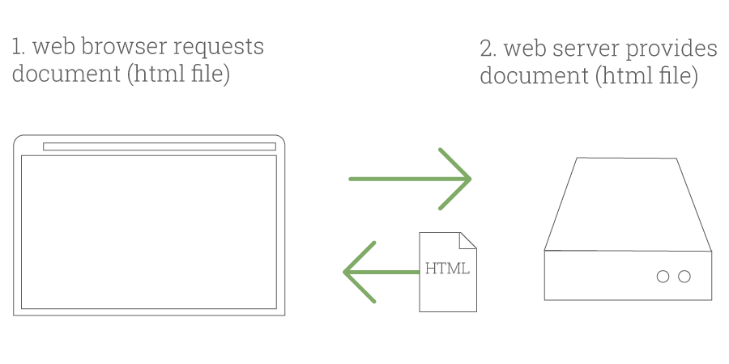
Response #1
Beginning: Respond html

Slide 27
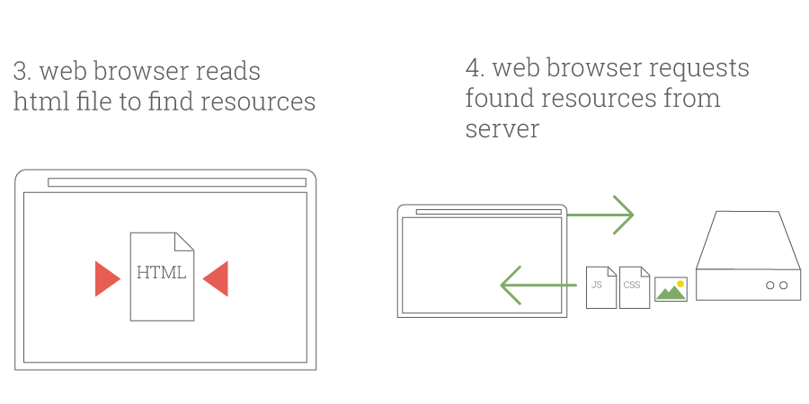
Response #2
Parse, then request & respond more

Slide 28
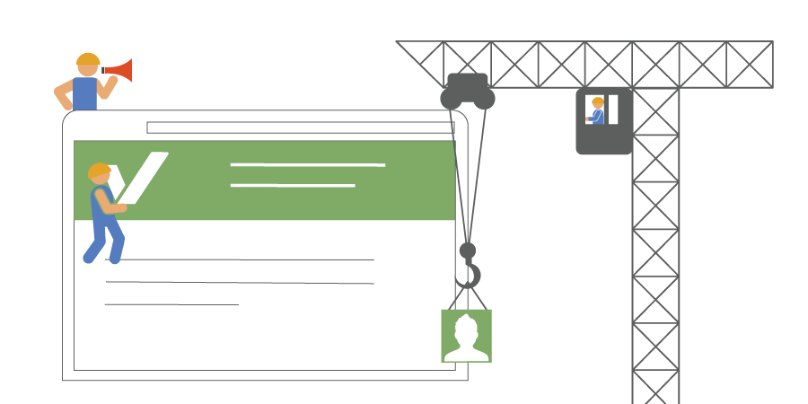
Build
Build the page
DOM
CSSOM
Render tree

Slide 29
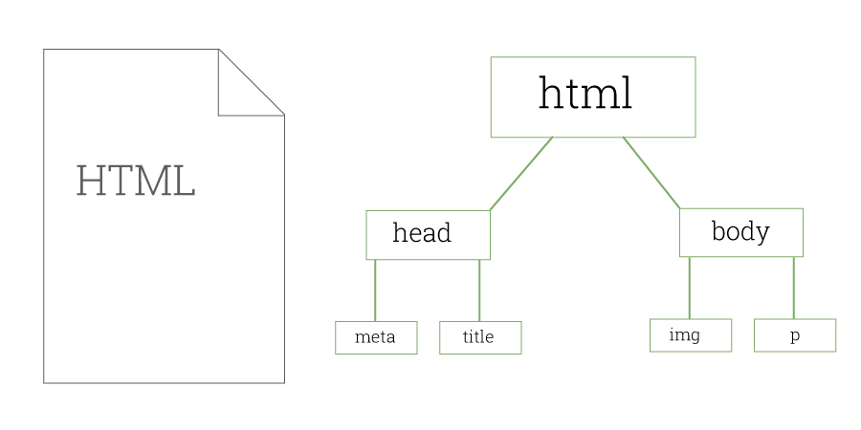
Build: DOM
DOM: Document Object Map
Map of where things are displayed on a page according to the HTML

Slide 30
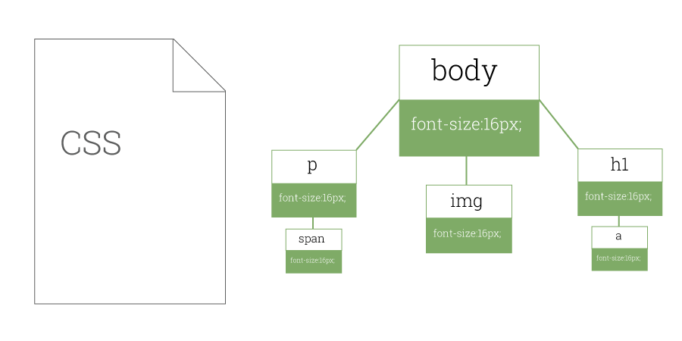
Build: CSSOM
CSSOM: CSS Object Map
Map of what styles should be applied to different parts of the page according to the CSS

Slide 31
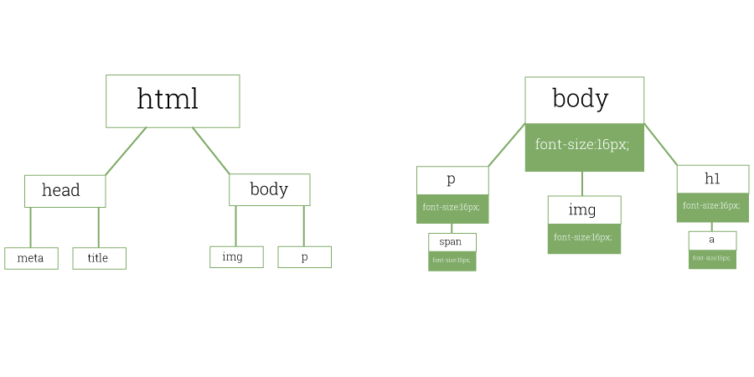
Build: Render tree
Render tree
Takes the DOM and the CSSOM and combines them to create a full map of how the page will actually be laid out and painted

Slide 32
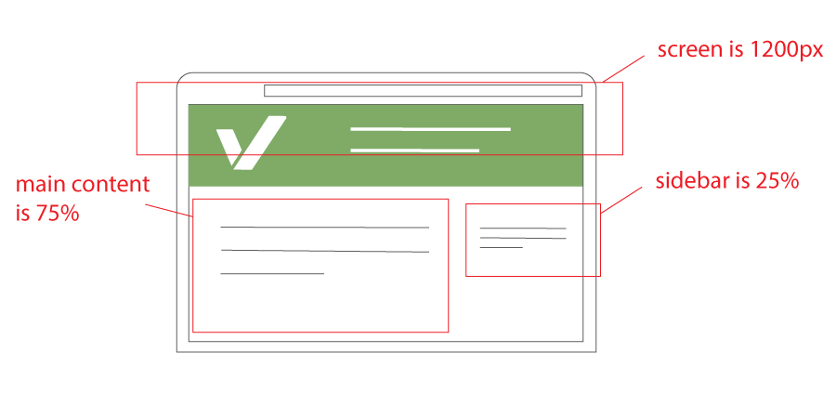
Render: Layout / Reflow
Browser determines how big a screen is and how that will affect the way the page is displayed

Slide 33

Render: Paint
Browser converts each node in the render tree to actual pixels on the screen

Slide 34
Recap: 4 steps to display a webpage
Request
A request is made when a link is clicked
Response
The page and its resources (files) are downloaded
Build
The web browser uses the page resources to build the page
Render
The page then is rendered (displayed) to the user

Slide 35
Demo
https://1989chenguo.github.io/

Slide 36
Case study: Accelerating webpage load time

Slide 37
Case #1:
QUIC
Materials from “QUIC Tutorial - IETF Meeting Talk” & “QUIC - SIGCOMM’17 Talk”
Notes:
Next, we’ll look at an improvement at the transport layer.

Slide 38
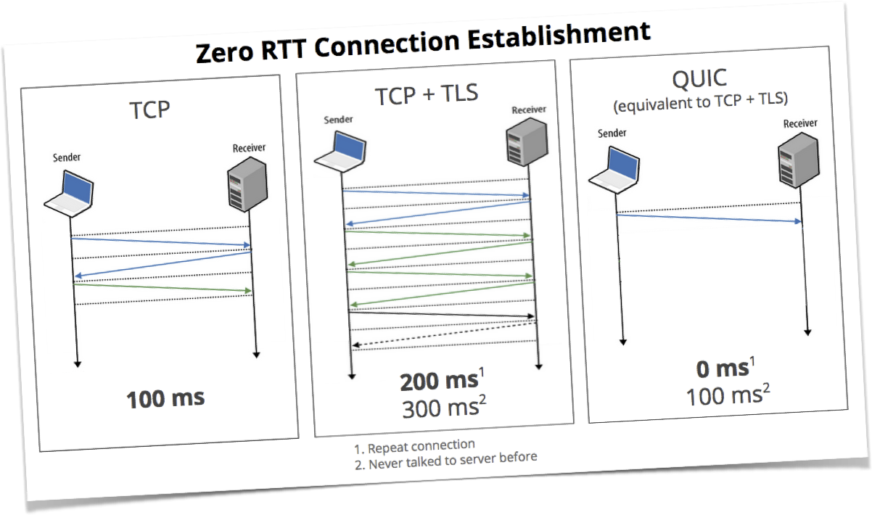
Google’s QUIC
“QUIC, a multiplexed stream transport over UDP”, https://www.chromium.org/quic
Notes:
Given the value of the problem, a lot of ways of reducing latency are being explored. One example approach is Google’s QUIC, which aims to get rid of the TCP handshake overhead as well as TLS setup overhead, among other things. How do we get rid of the TCP handshake? To do so, we first need to understand what function the handshake serves and how we might get that function without the overhead of the round trip. The handshake helps prevent denial of service attacks — before the handshake is complete, the server does not spend significant resources on the client. The client sends the SYN, the server returns a SYN-ACK, but only after the client sends back the ACK, does the server look into its request. This means, for one, that the client cannot spoof its IP address and succeed with the handshake — it has to be able to receive the server’s SYN-ACK, and to respond to it!
So now, how do we get rid of the handshake, without breaking this useful property? QUIC depends on using what is called a TCP cookie. Briefly, the first time a client connects to a service, it does incur the cost of the handshake. But successful completion of the handshake results in the client obtaining a cryptographic token or cookie from the service. The next time the client connects to the service, it may send this cookie, together with its data request. The server authenticates the cookie, and if valid, fulfills the data request.
QUIC is a work in progress, but Google is already testing it live — if you’re using Chrome, chances are you’ve used QUIC. There is of course, lots of other work on network improving protocols for lower latency.

Slide 39
Evolution of Web Protocols
HTTP/0.9
HTTP/1.1
HTTP/2.0
1991
1997
2015
1996
2006
2014
2016
HTTP/1.0
SPDY
QUIC
QUIC
IETF WG Formed

Slide 40
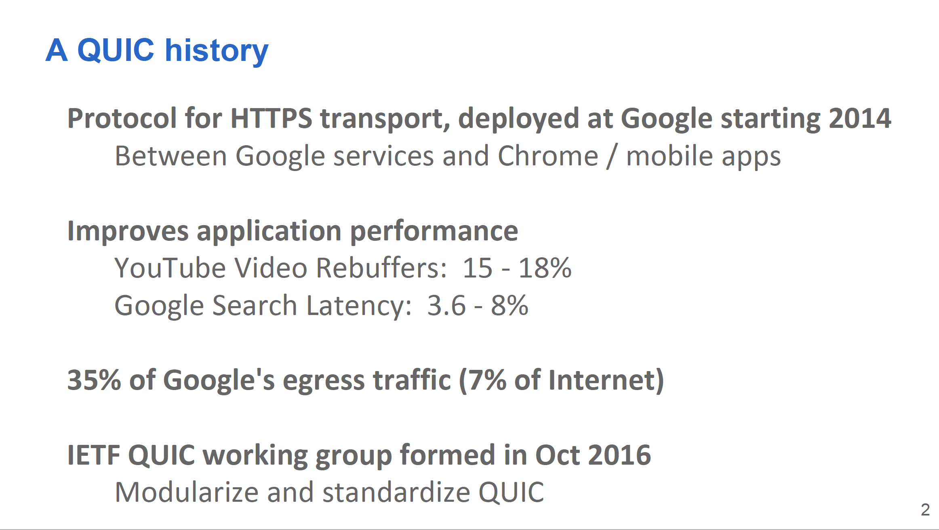

Slide 41
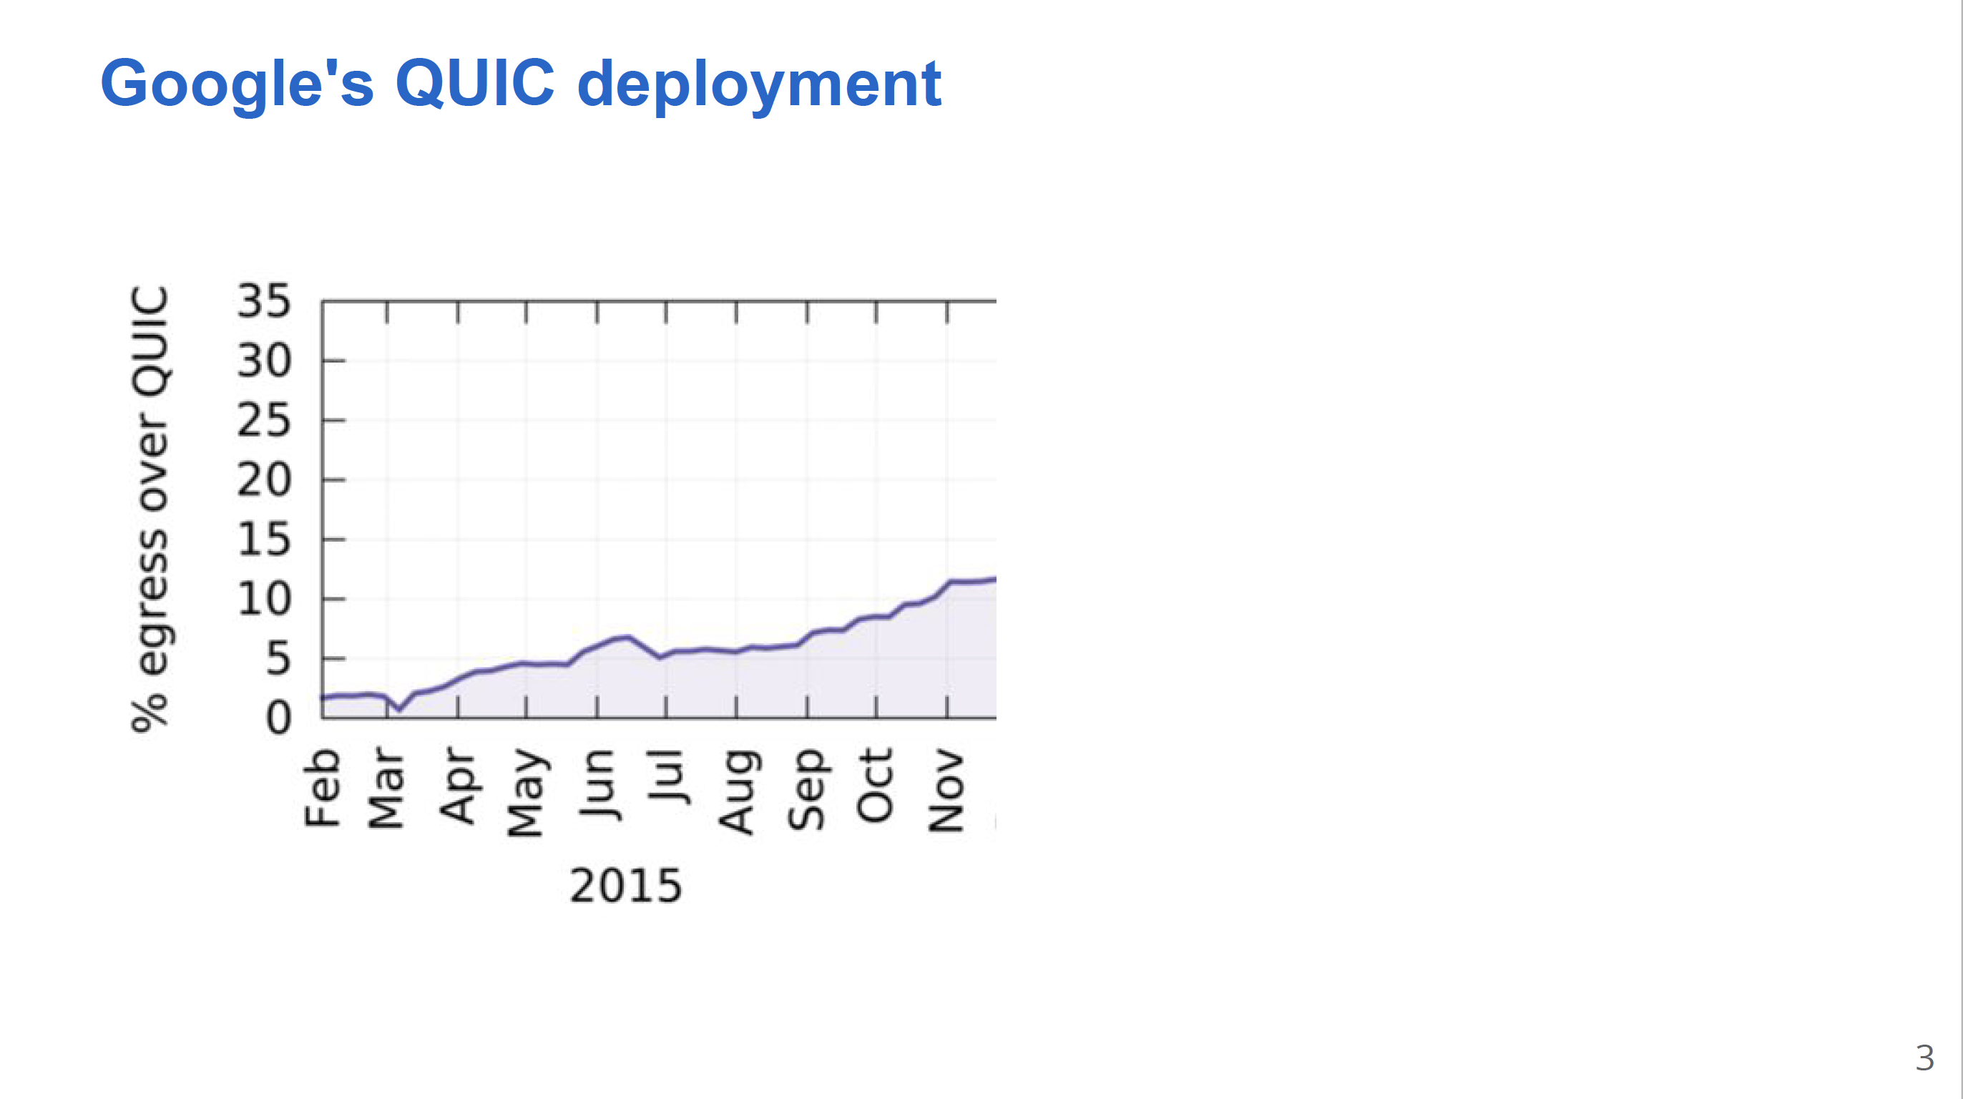

Slide 42
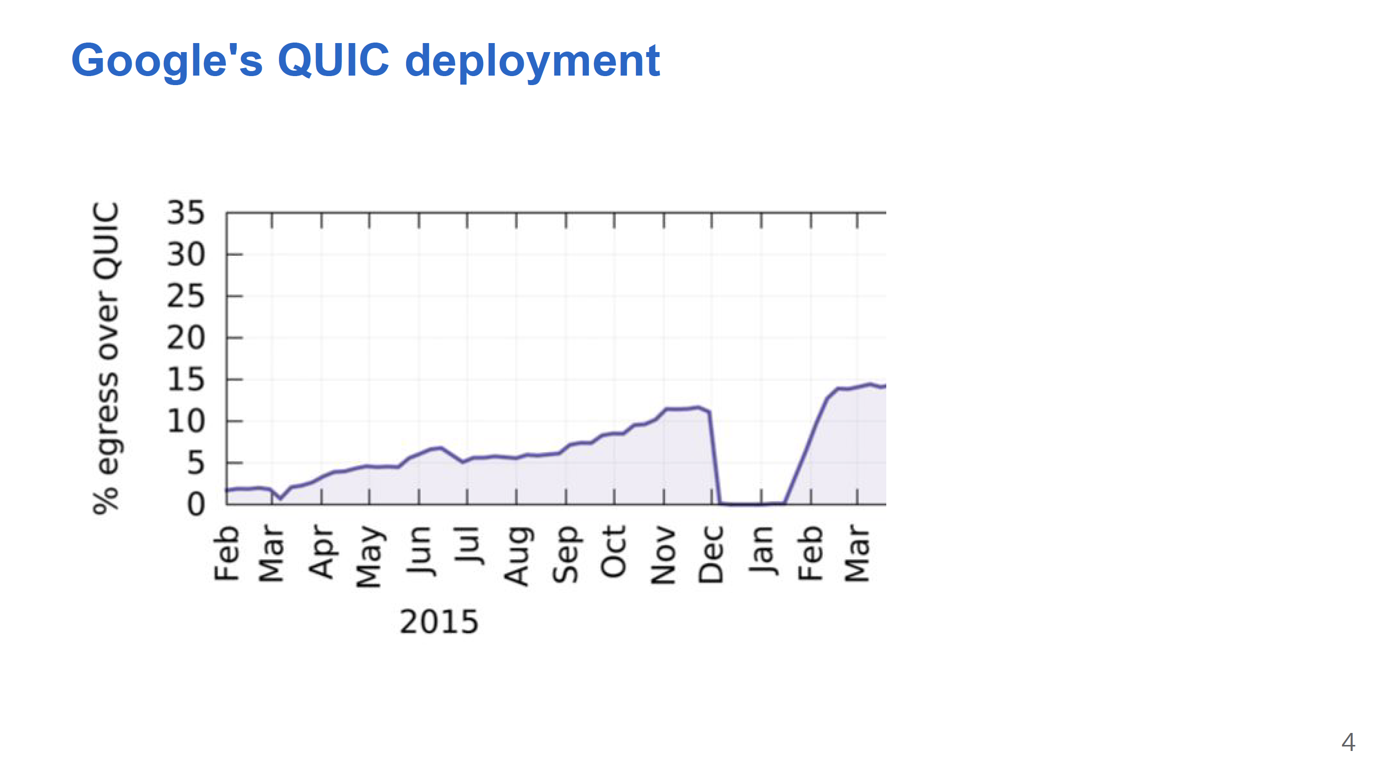

Slide 43
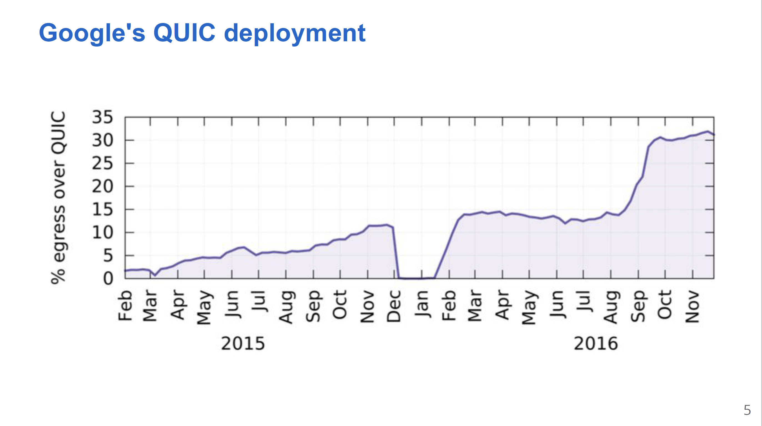

Slide 44
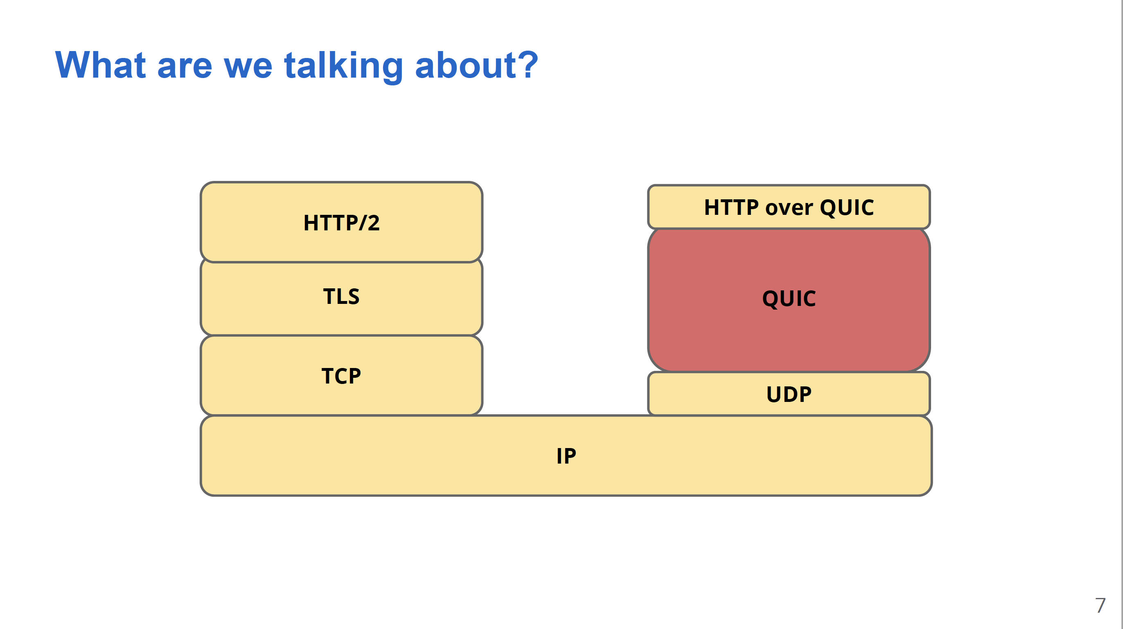
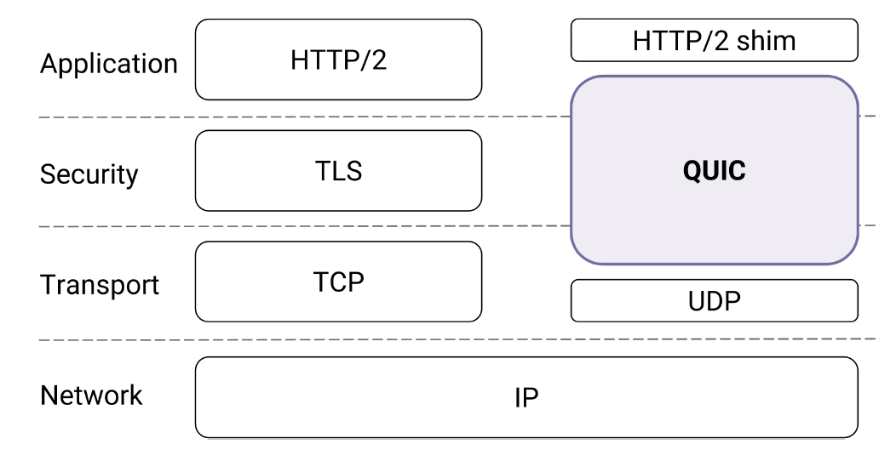

Slide 45
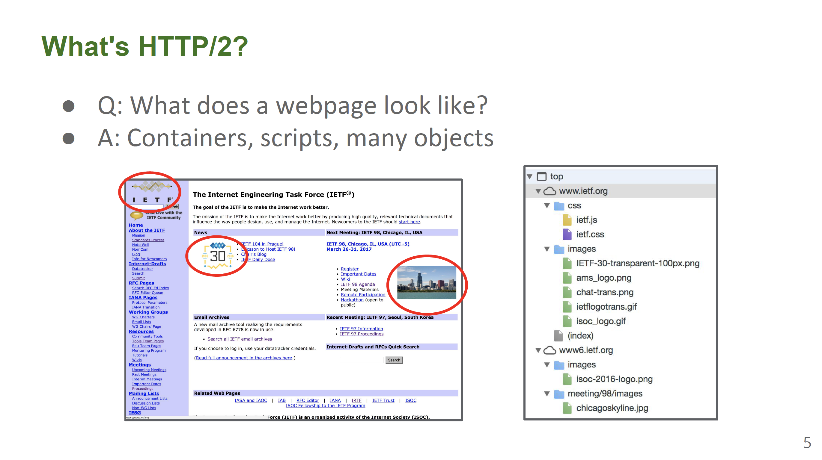

Slide 46
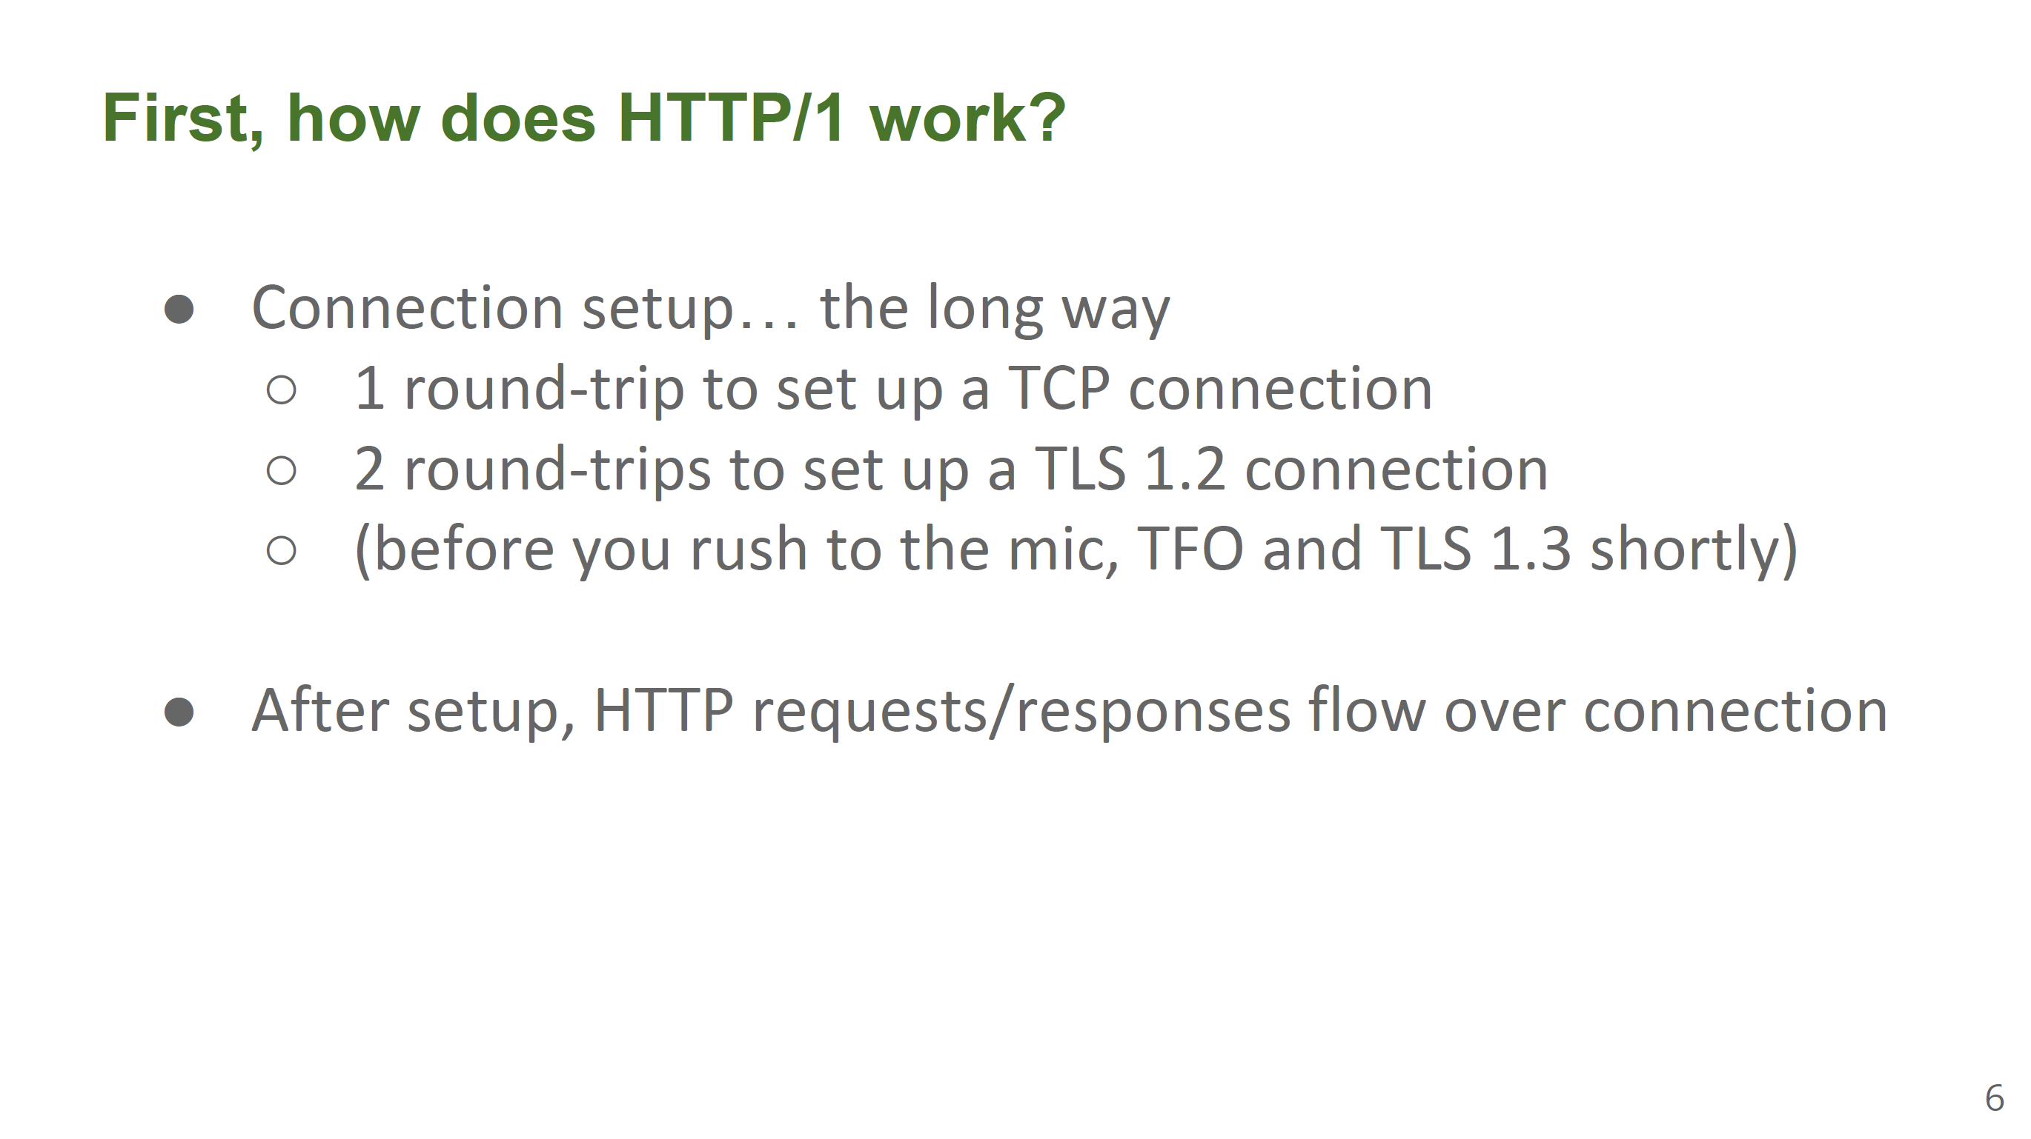
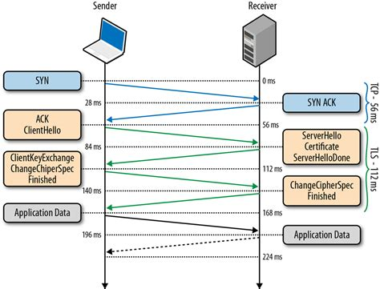

Slide 47
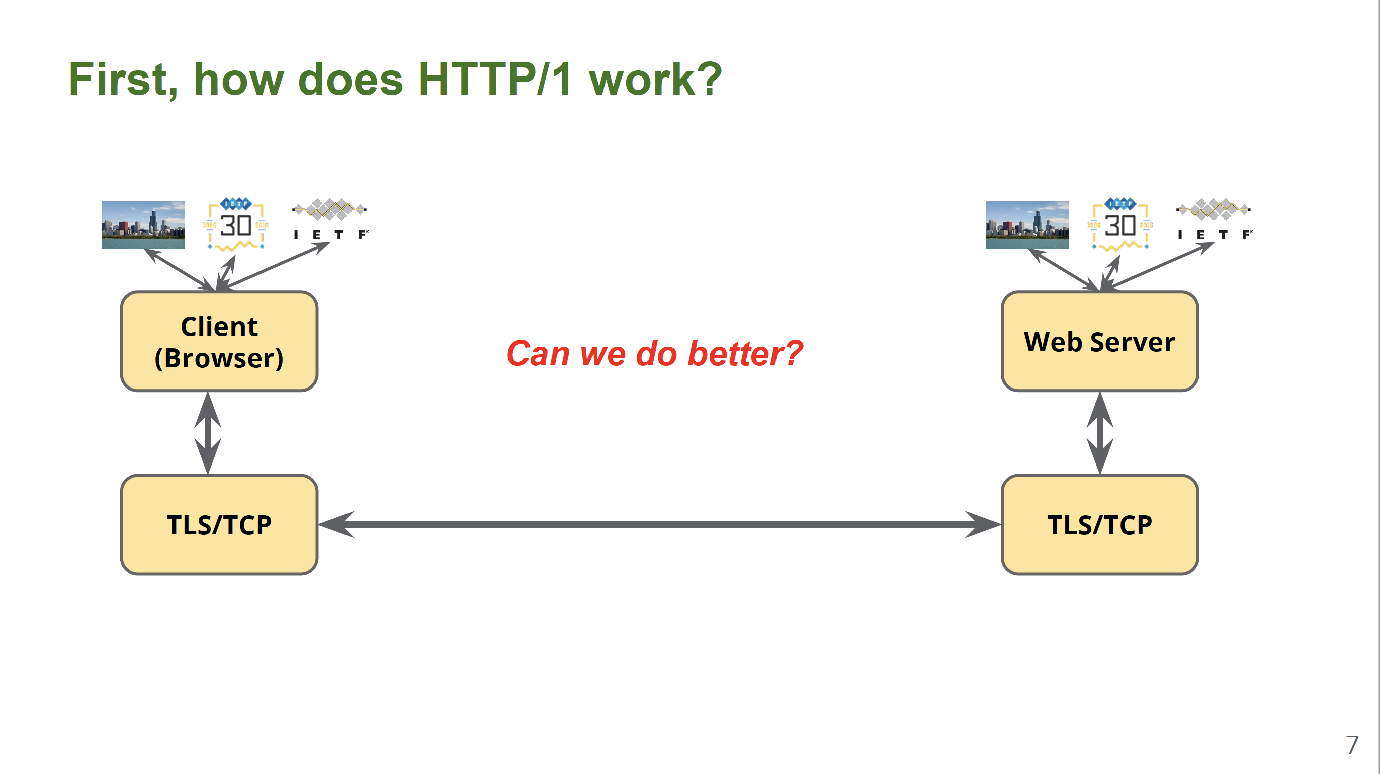

Slide 48
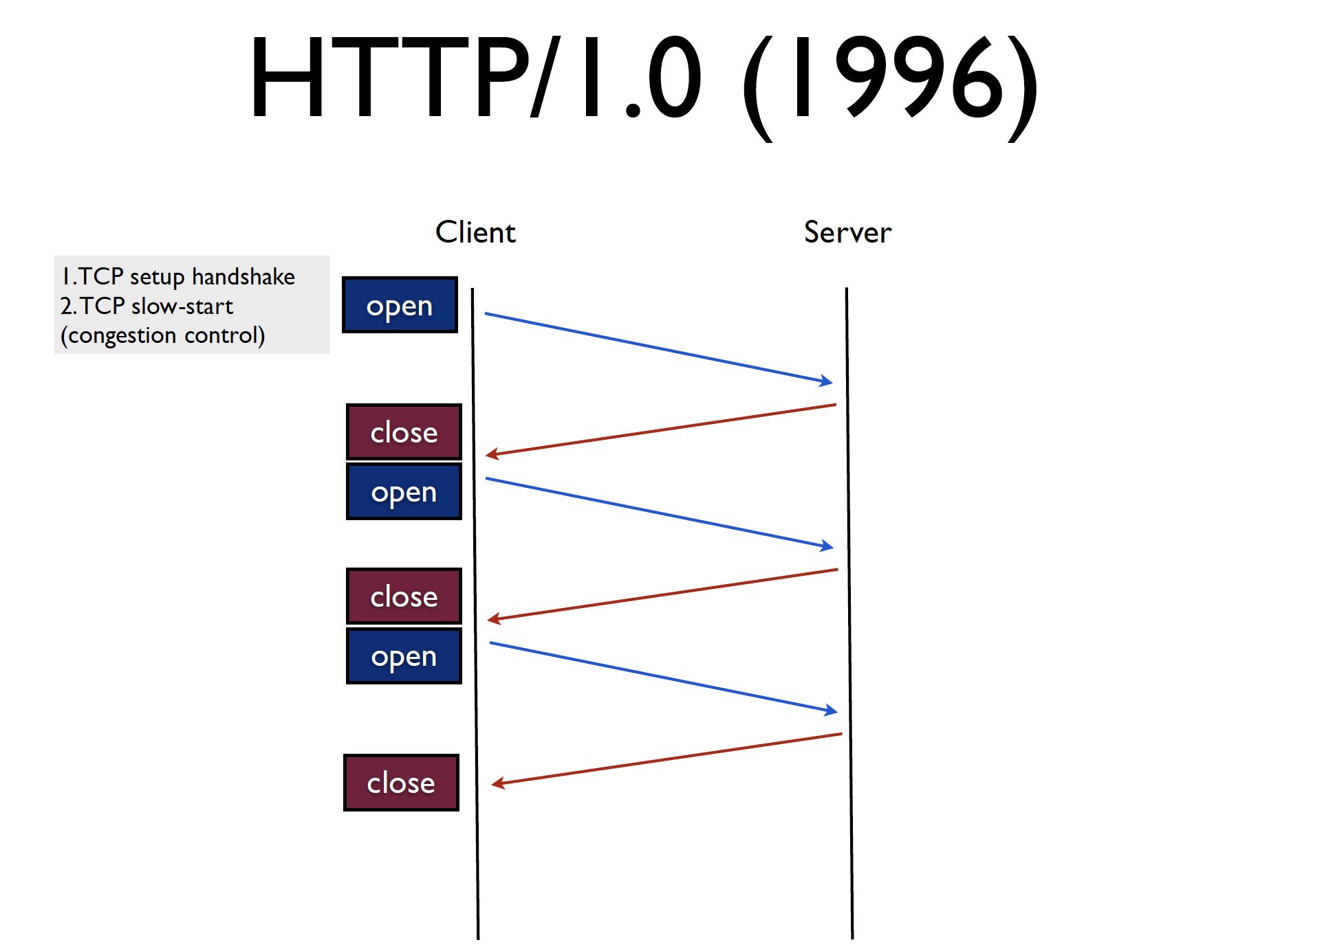
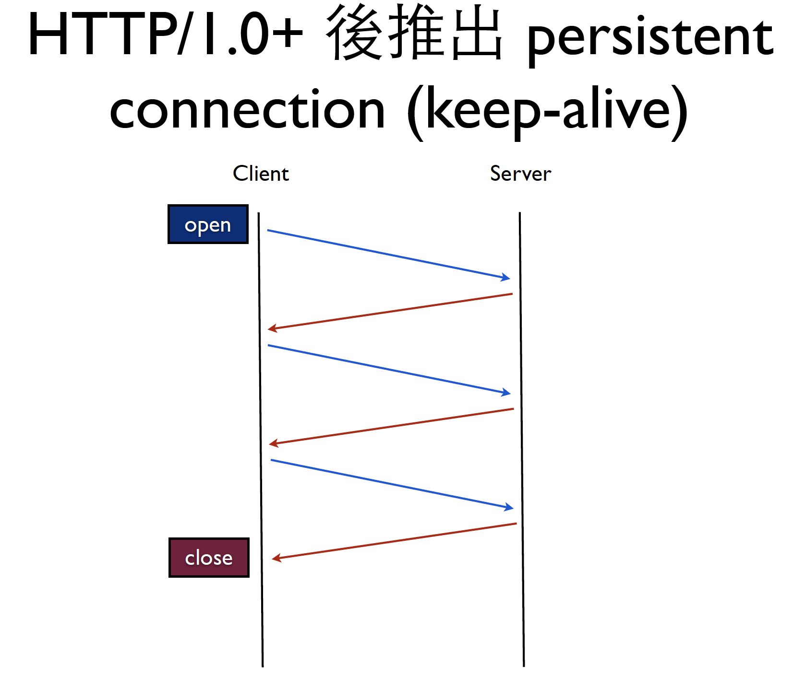
From “A brief introduction to SPDY”, http://ihower.tw

Slide 49
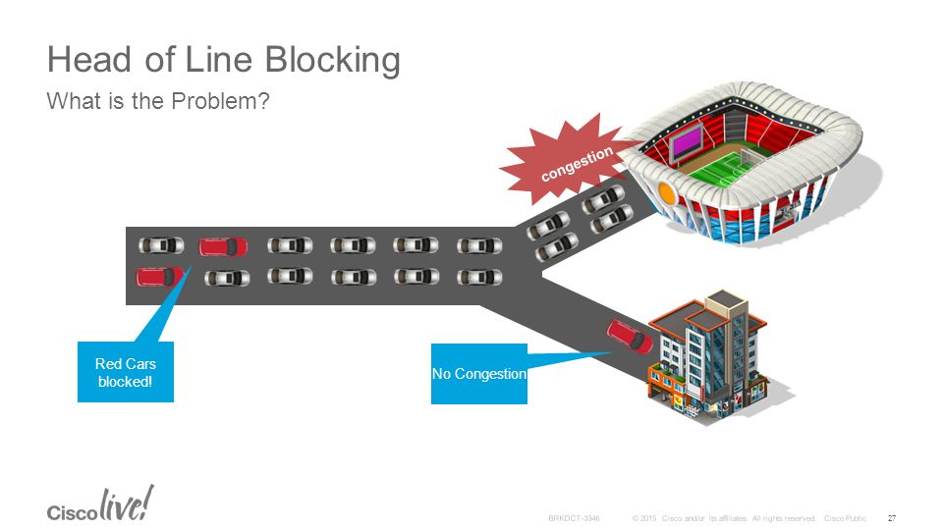

Slide 51
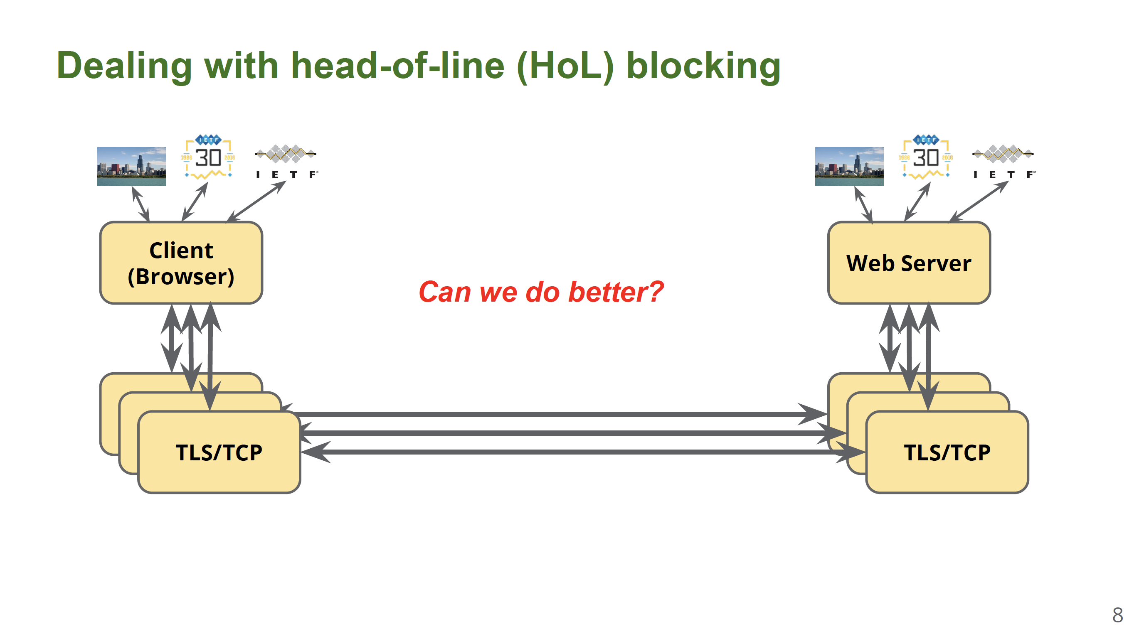

Slide 52
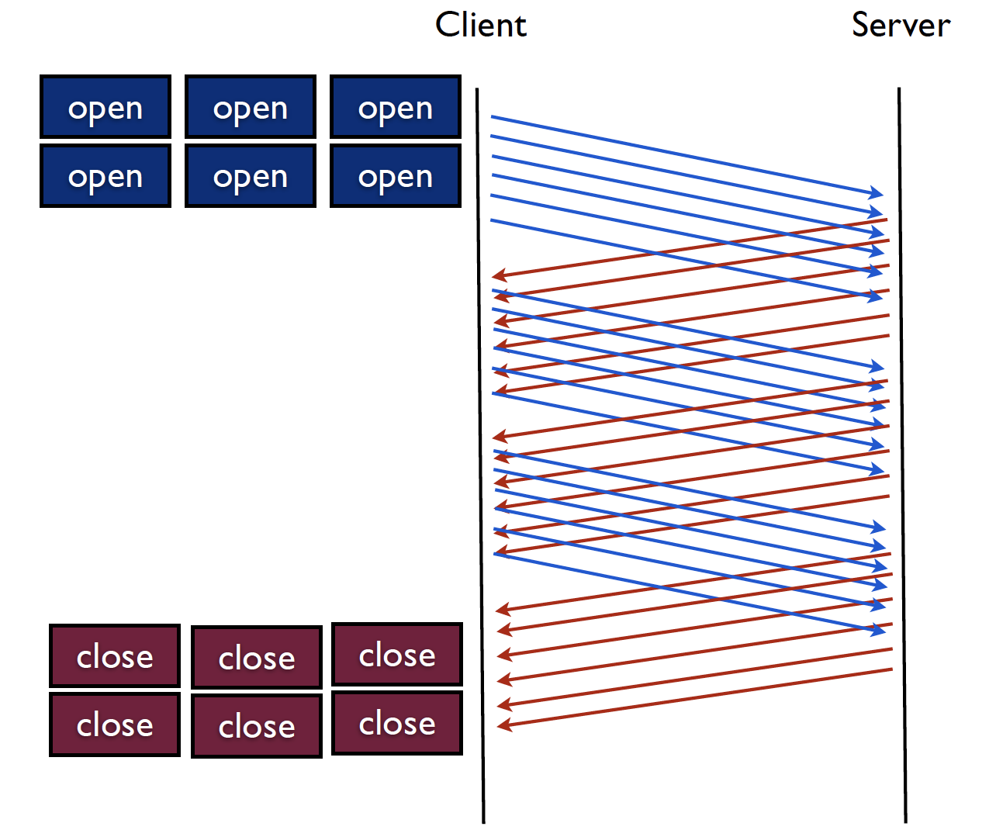
Too many connections consume a lot of resources
From “A brief introduction to SPDY”, http://ihower.tw

Slide 54
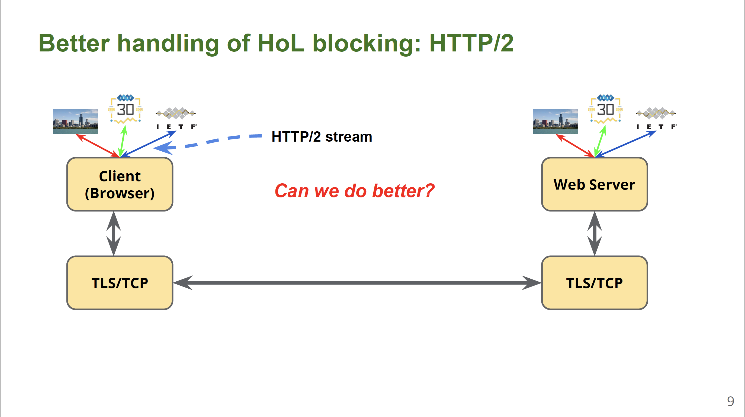

Slide 55
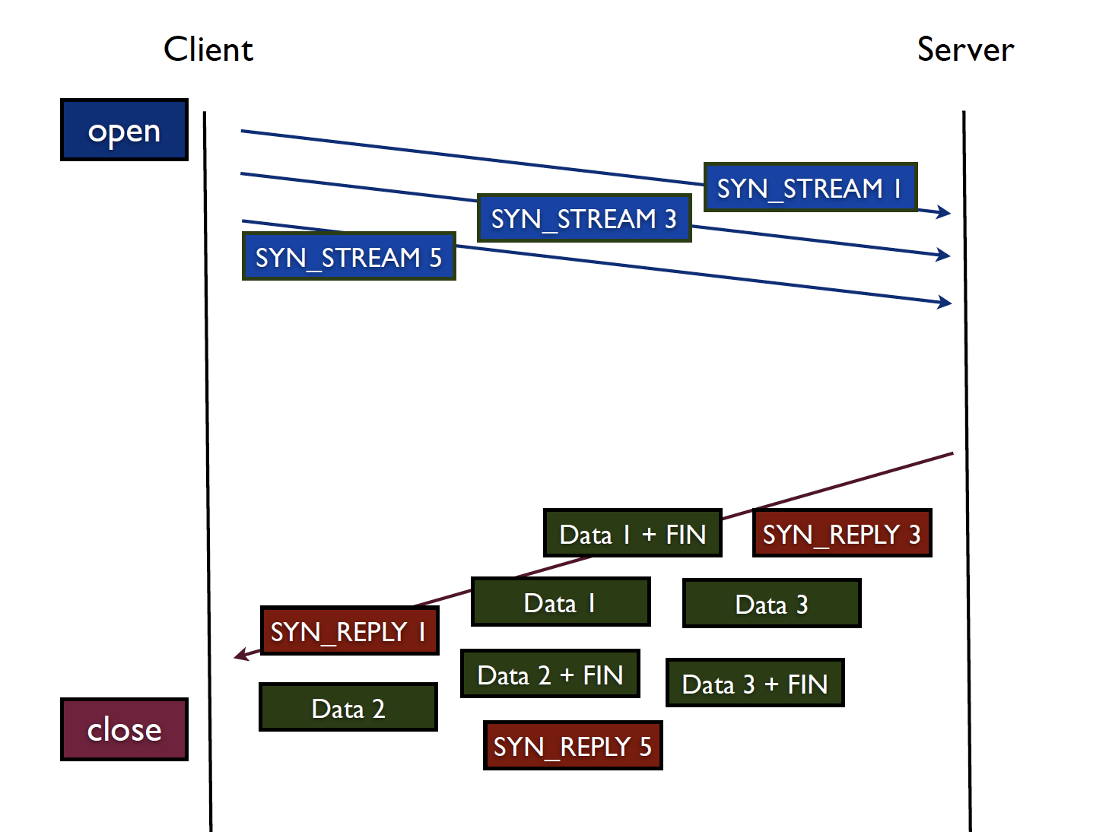
TCP-level HoL Blocking：
In-order stream transmission
From “A brief introduction to SPDY”, http://ihower.tw

Slide 57
Evolution of Web Protocols
HTTP/0.9
HTTP/1.1
HTTP/2.0
1991
1997
2015
1996
2006
2014
2016
HTTP/1.0
SPDY
QUIC
QUIC
IETF WG Formed

Slide 58
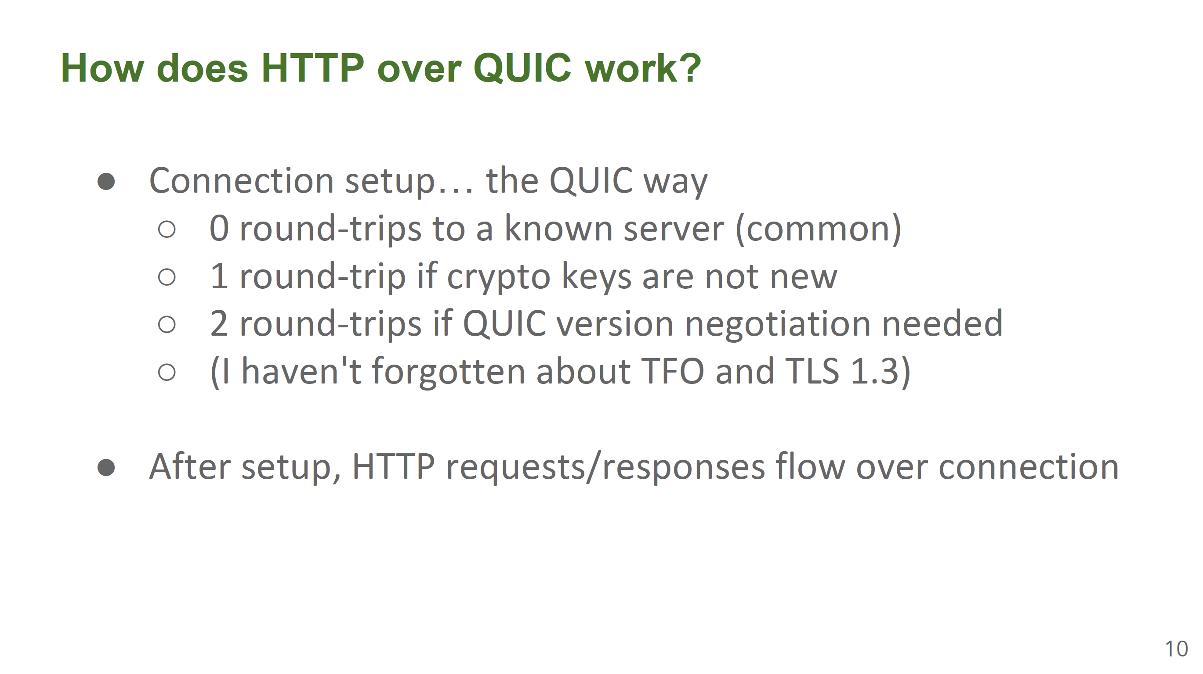
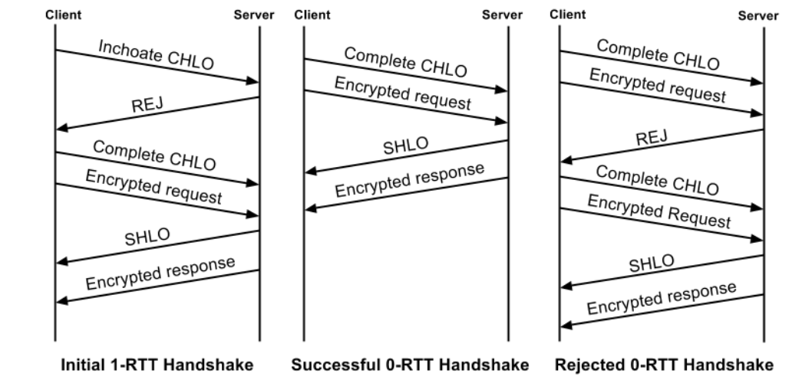

Slide 59
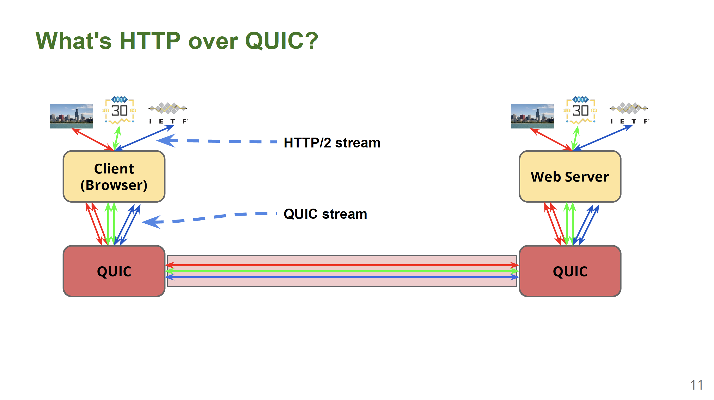
On-top-of UDP Transport

Slide 60
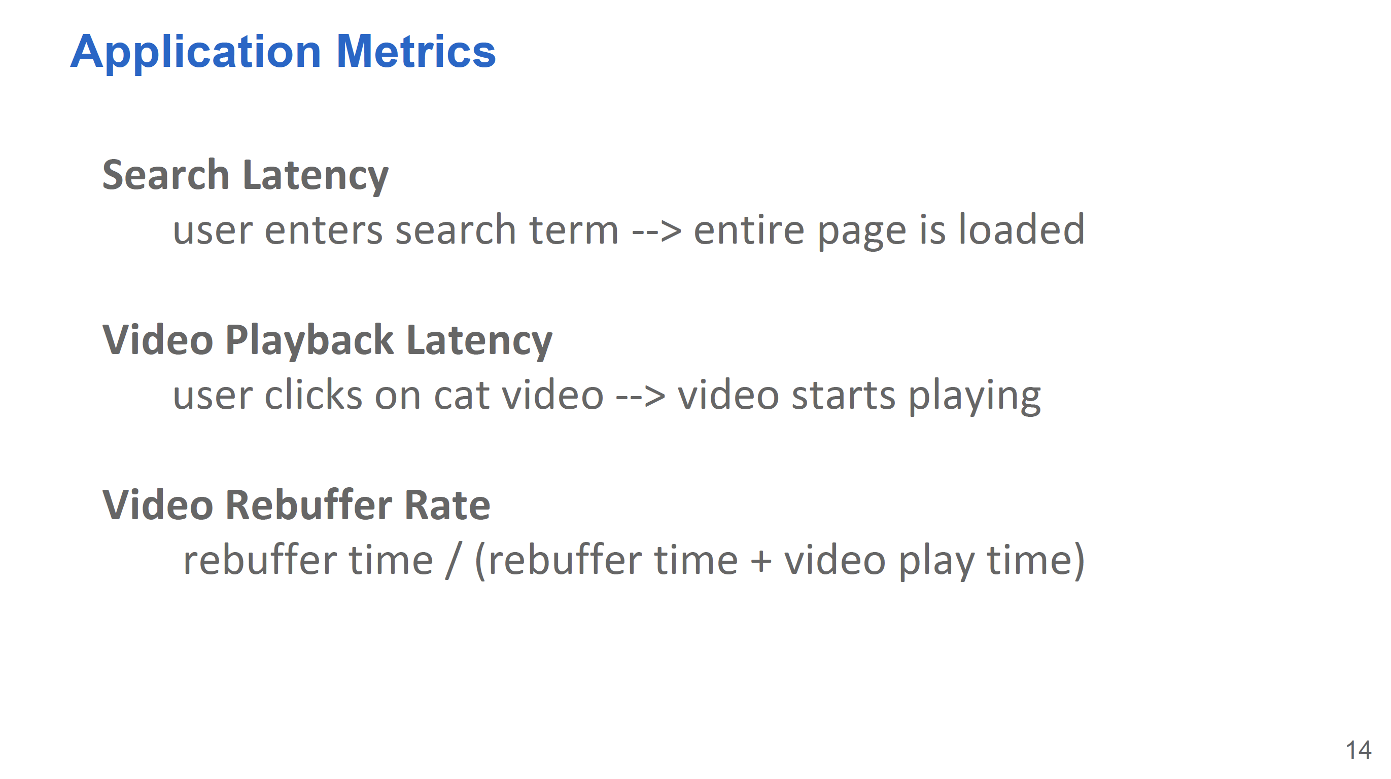
How QUIC Performs

Slide 61
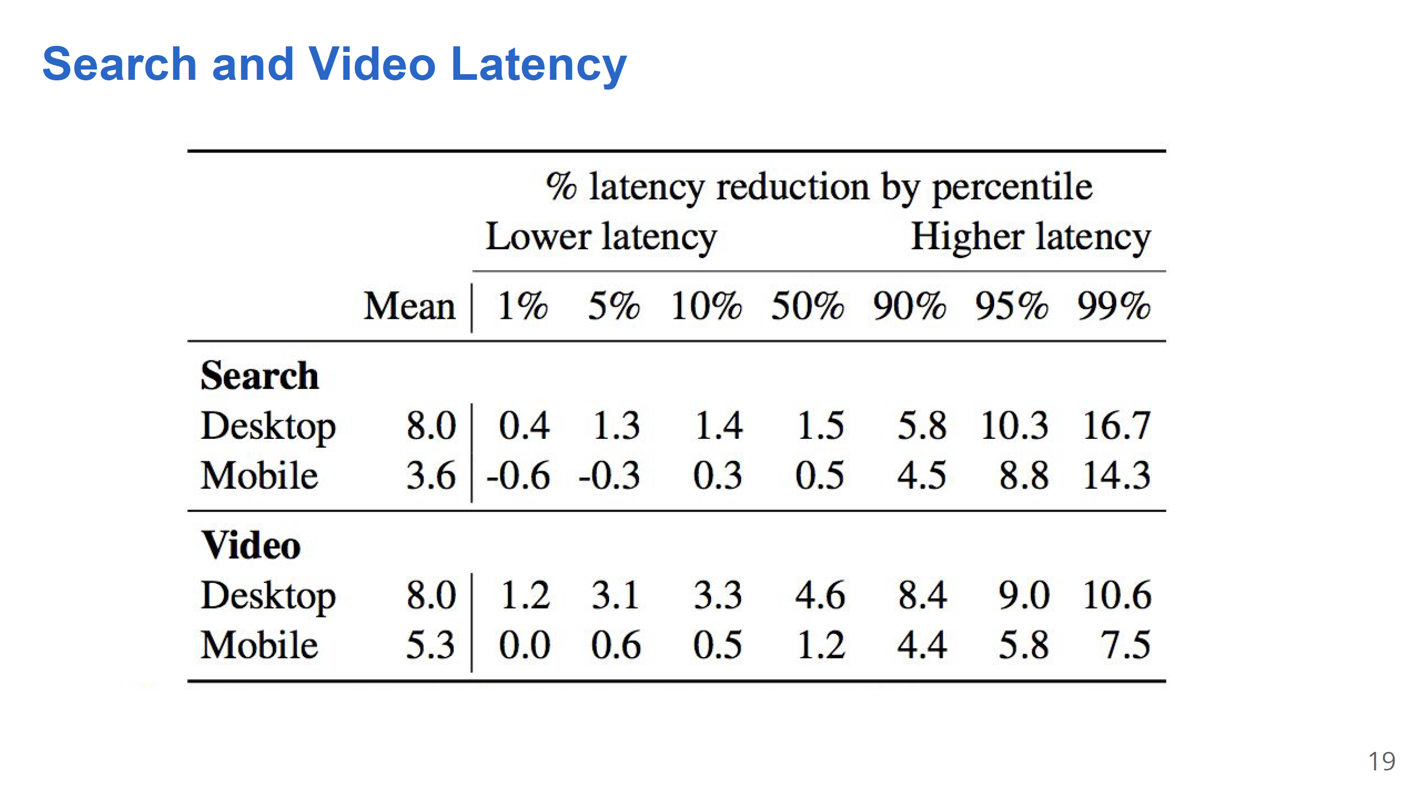

Slide 62
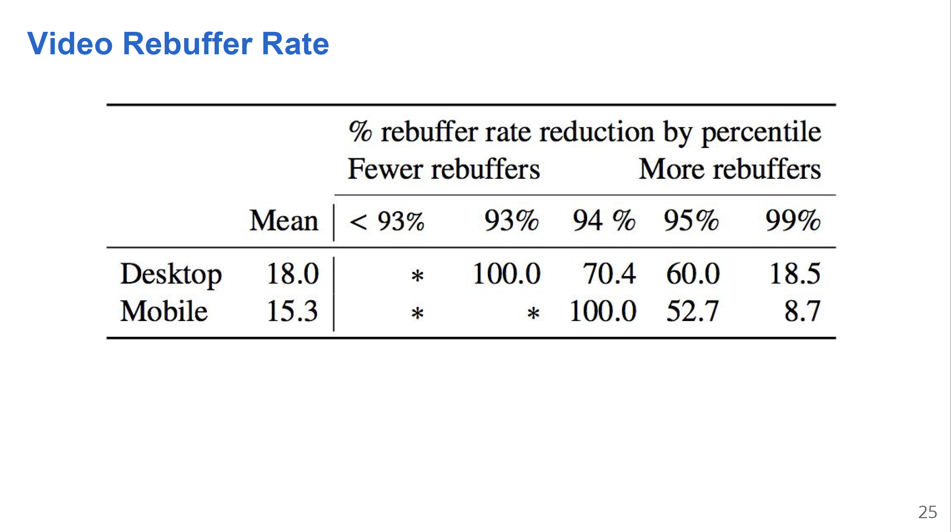

Slide 63
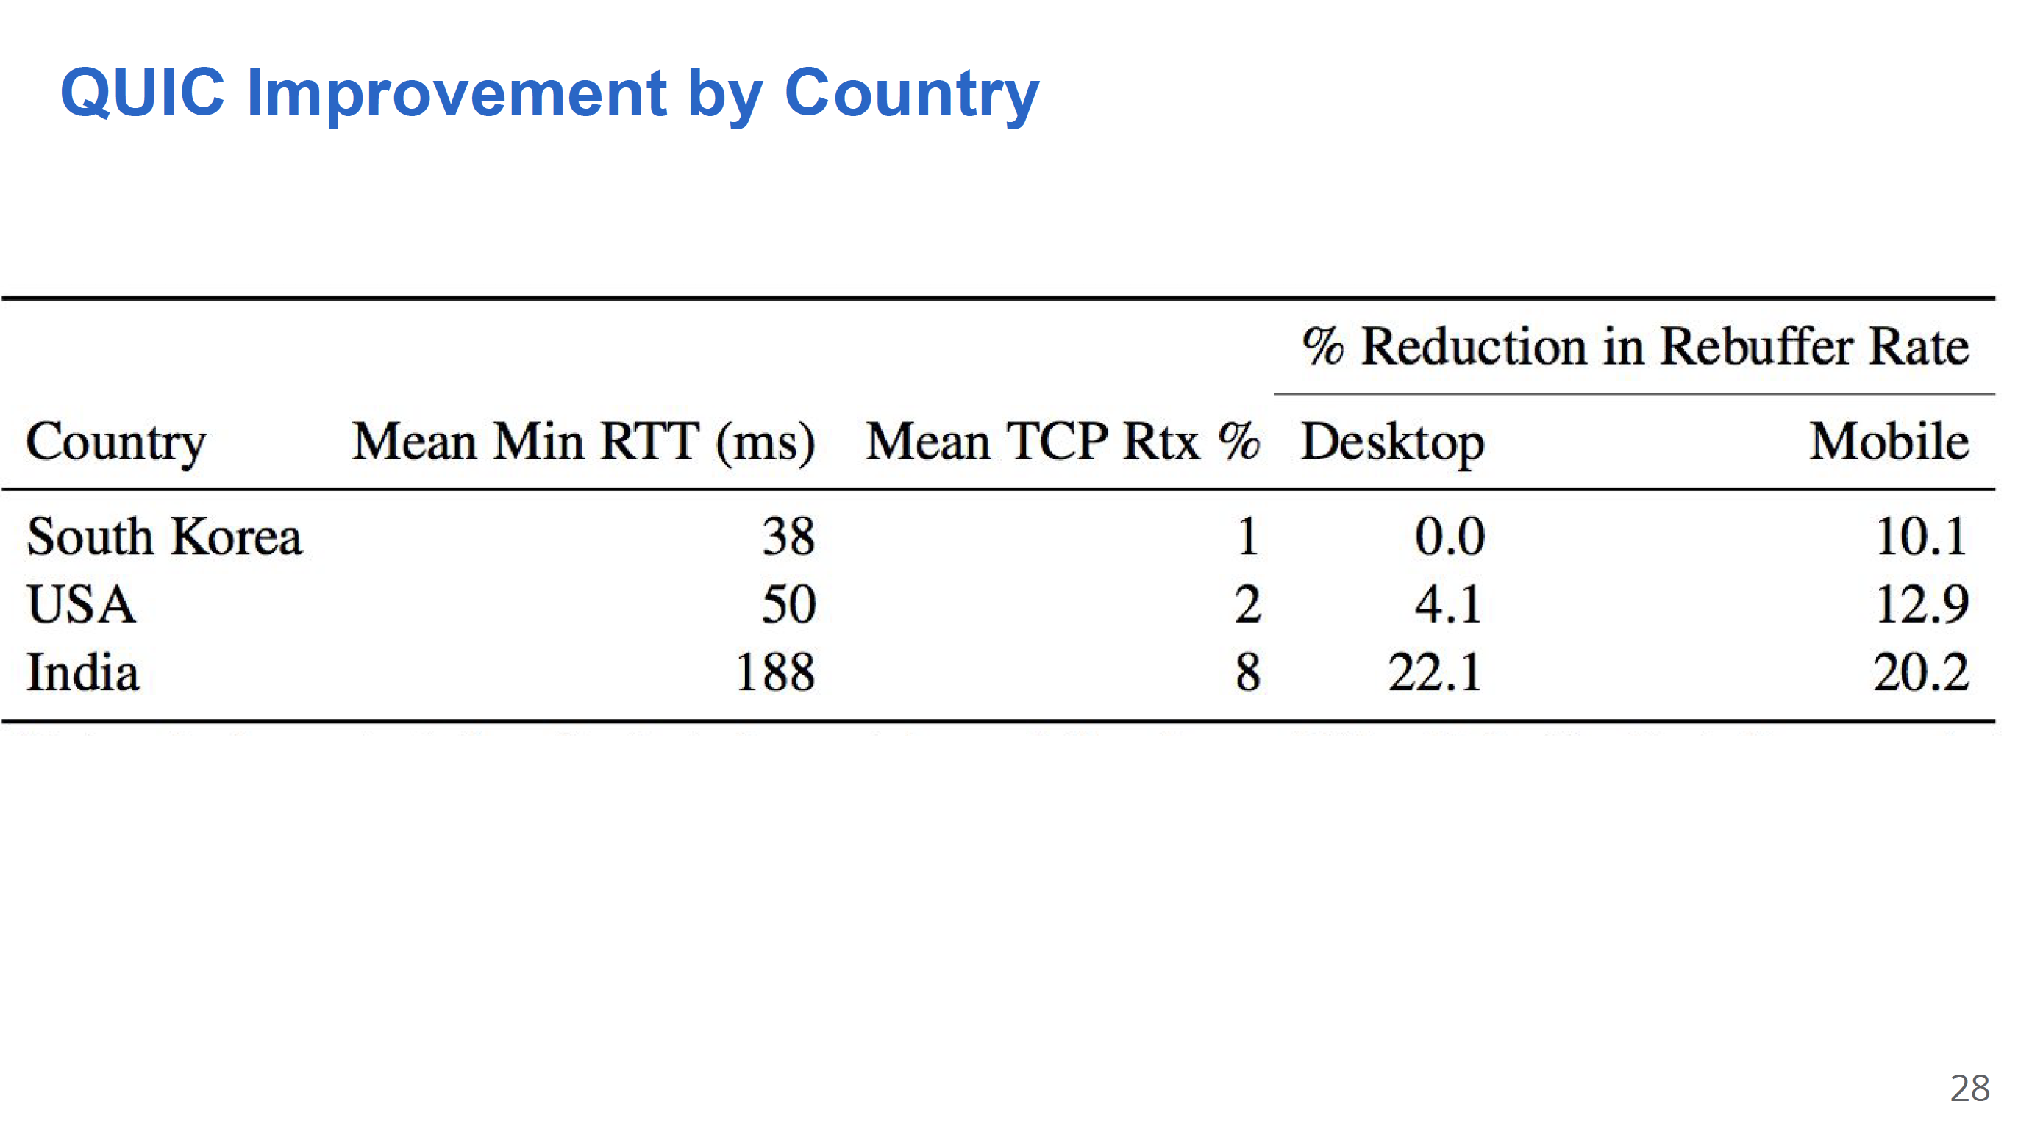

Slide 64
Thanks!
陈果 副教授
湖南大学-信息科学与工程学院-计算机与科学系
邮箱：guochen@hnu.edu.cn
个人主页：1989chenguo.github.io
https://1989chenguo.github.io/Courses/CloudComputing2018Spring.html

